Slide 1

UE20CS390A – Capstone Project Phase – 1
SEMESTER - VI
END SEMESTER ASSESSMENT
Project Title : Black Box Attacks on Interpretable Deepfake GANs
Project ID : PW23_PK_04
Project Guide : Prof. Preet Kanwal
Project Team :
PES1UG20CS124 K M Dhanalakshmi
PES1UG20CS157 Hamsini S
PES1UG20CS172 Ishika Agrawal
PES1UG21CS807 Bhavana S

Slide 2
Outline
BLACK BOX ATTACKS ON INTERPRETABLE DEEPFAKE GANs
Problem Statement
Abstract and Scope
Literature Survey
Suggestions from Review – 3
Design Approach
Design Constraints, Assumptions & Dependencies
Proposed Methodology / Approach
Architecture
Design Description
Technologies Used
Project Progress
References

Slide 3
Abstract and Scope
BLACK BOX ATTACKS ON INTERPRETABLE DEEPFAKE GANs
Deepfake images and videos are very popular today. As the generators are becoming more sophisticated, the detectors are also gaining importance.
Recent works have also shown that neural network interpretability is susceptible to adversarial manipulations.
We propose to modify an existing Deepfake Generative Adversarial Network (Deepfake GAN) such that it can detect Deepfake images as well. We are planning to work on two popular GANs , Style GAN for identity swap and Star GAN for attribute manipulation .
Dhanalakshmi_Hamsini_Ishika_Bhavana

Slide 4
Abstract and Scope
BLACK BOX ATTACKS ON INTERPRETABLE DEEPFAKE GANs
The model is subjected to two-step black-box attack to check its susceptibility to advanced black box attacks.
The first step of the attack is to generate adversarial image using existing decision based methods such as
EA [Evolutionary Attack algorithm]
Sign-OPT
HSJA [Hop Skip Jump Attack ]
The second step is an optimization technique where the image generated from step 1 is modified such that similarity between the heatmaps of the benign and adversarial image is high [ADV plugin] .
We will also attempt to provide a suitable defense mechanism based on the results of the attack.
Dhanalakshmi_Hamsini_Ishika_Bhavana

Slide 5
Problem Statement
BLACK BOX ATTACKS ON INTERPRETABLE DEEPFAKE GANs
The project aims to build a Deepfake GAN architecture whose results are interpretable by using available visual interpreters such as Grad-CAM.
The model will be subjected to dual black box attack and the efficacy of the attack is measured by the classification accuracy.
According to the accuracy of the model under attack, a suitable defense mechanism will be deployed.
The effectiveness of the defense will also be measured using the classification accuracy parameter.

Slide 6
Literature Survey
BLACK BOX ATTACKS ON INTERPRETABLE DEEPFAKE GANs
Literature Survey is divide into four major parts .
ATTACK
GAN MODEL’s
INTERPRETERS
DEFENSE

Slide 7
DUAL BLACK-BOX ATTACKS
BLACK BOX ATTACKS ON INTERPRETABLE DEEPFAKE GANs
The dual black- box attack works in two steps:
Step 1: Using existing decision based attacks such as EA, Sign-OPT and HSJA to generate an adversarial image.
Step 2: ADV-plugin manipulating the regular AE to increase the similarity between benign and adversarial explanations.

Slide 8
DUAL BLACK-BOX ATTACKS
BLACK BOX ATTACKS ON INTERPRETABLE DEEPFAKE GANs
Step 1:
Crafting regular AE, can be completed by number of existing methods, such as EA, Sign-opt and HSJA.
These methods starts with adversarial image that classified to the target class and continuously reduces the distance between the benign and the adversarial images and also maintaining the effectiveness of AE.
Evolutionary Attack(EA):
The paper we referred for this attack “Efficient Decision-based Black-box Adversarial Attacks on Face Recognition”.

Slide 9
DUAL BLACK-BOX ATTACKS
BLACK BOX ATTACKS ON INTERPRETABLE DEEPFAKE GANs
Paper 1: Efficient Decision-based Black-box Adversarial Attacks on Face Recognition
Authors: Yinpeng Dong , Hang Su , Baoyuan Wu , Zhifeng Li , Wei Liu , Tong Zhang , Jun Zhu.
Conference: Computer Vision and Pattern Recognition.
Year of Publication: 2019
Dataset: Labeled Face in wild (LFW) and MegaFace.
Problems addressed:
Existing attack methods for face recognition are mainly based on the white-box scenario, where the internal structure of system is being attacked, which impractical in real-world cases, when the attackers cannot get access to the model details.
Several methods have been proposed to perform decision-based black-box attacks, they lack efficiency in sense that they usually require tremendous number of queries, or get large perturbation given a limited budget of queries.

Slide 10
DUAL BLACK-BOX ATTACKS
BLACK BOX ATTACKS ON INTERPRETABLE DEEPFAKE GANs
Solutions:
Focus is on decision-based black-box setting, where no model information is exposed that attacker can only query the target model and obtain hard-label predictions .
Proposes an evolutionary attack method for query-efficient adversarial attacks in the decision-based black-box setting.
Approaches:
They propose EA method under the decision-based black-scenario, which can model the local geometrics of the search direction and reduce the search space.
Evaluates the robustness of several state-of-the-art face recognition models, demonstrating the vulnerability of these face models in the decision-based black-box setting.
Applies the proposed method to study the robustness of sphereFace,CosFace and ArcFace.
Methodology:
It is based on covariance matrix adaptation evolution strategy. a new candidate solution is generated from the current solution by adding random noise, the objective of these two solution are evaluated and better one is selected for the next iteration.
Applying directly this strategy to optimize is inefficient due to the high dimension of the AE.

Slide 11
DUAL BLACK-BOX ATTACKS
BLACK BOX ATTACKS ON INTERPRETABLE DEEPFAKE GANs
The query limit in decision-based black-box attacks for face images using (1+1)-CMA-ES may be infeasible. Instead of using n-dimensional input space, we perform searches in lower dimension space
R ^m with m < n.
In each iteration we sample a random vector z from N (0, σ2C) such that z ∈ R m, where C is a diagonal covariance matrix to model the local geometrics of search directions.
We select k coordinates randomly for search, with the assumption that only a fractions of pixels are important for finding an adversarial image.
We upscale z to the input space by bilinear interpolation and get z˜ ∈ R ^n.
And we add bias to z˜ to minimize the distance between the adversarial and original images.
And finally a test to check if we get a better solution or not, if we get a better solution we
continue and update the covariance matrix.
Evaluation metrics:
conduct experiments on two widely used face recognition datasets: LFW and MegaFace. They compare the attack success rates of their algorithm to those of other state-of-the-art methods

Slide 12
DUAL BLACK-BOX ATTACKS
BLACK BOX ATTACKS ON INTERPRETABLE DEEPFAKE GANs
Step 2:
ADV-Plugin
Paper Title: Towards Black-Box Adversarial Attacks on Interpretable Deep Learning Systems
Authors: Yike Zhan, Baolin Zheng, Qian Wang, Ningping Mou, Binqing Guo, Qi Li, Chao Shen, Cong Wang
Conference: International Conference on Multimedia and Expo (ICME).
Year of Publication: 2020
Datasets: ImageNet, CIFAR-10.
It is based on random search which is efficient iterative approach for black-box optimization.
the proposed scheme in the paper differs from classical random search, designing method from two perspectives.
Perturb only one pixel of AE at a time to keep it being classified as the target class.
To make the overall perturbation as small as possible, by selecting the sample that is closer to the benign one.

Slide 13
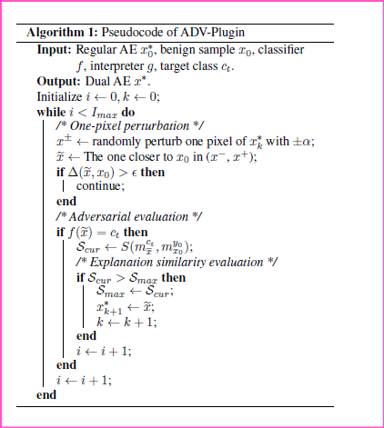
DUAL BLACK-BOX ATTACKS
BLACK BOX ATTACKS ON INTERPRETABLE DEEPFAKE GANs
Assuming that we have a regular AE x∗ produced by from step 1 and the step size α. During the search, we first randomly select one pixel of x∗ ^k and perturb it by adding or subtracting α, and get two samples: x− and x+. Then, we select the one that is closer to the benign sample from x− and x+ as a temporary sample ~x. We update x∗ k+1 with ~x when ex meets three conditions:
(i) The Distance between ex and benign sample x0 is smaller than ϵ. (ii) ex is misclassified as ct. (iii) ex increases the similarity
between benign and adversarial explanations. Otherwise, we
randomly select another pixel.
By iteratively executing the above steps, we can obtain the final dual AE. The search ends when the max query number I max is reached.
k is the number of updates of x∗. The step size α is positively
related with the l2 distance between the benign and
adversarial explanations.
Evaluation metrics:
measure the l2 distance and IoU score between benign and adversarial attribution maps

Slide 14
GAN [GENERATIVE ADVERSARIAL NETWORK]
BLACK BOX ATTACKS ON INTERPRETABLE DEEPFAKE GANs
Paper 2 : Deep fake Detection For Human Face Images And Videos: A Survey
Authors : Asad Malik (Member, Ieee), Minoru Kuribayashi (Senior Member, Ieee),
Sani M. Abdullahi (Member, Ieee) And Ahmad Neyaz Khan
(Member, Ieee)
Date Of Publication: 11 February 2022
This Article Offers A Comprehensive Survey Of A New And Prominent Technology,
Namely, Deepfake. It Communicates The Basics, Benefits And Threats Associated
With Deepfake, Gan-Based Deepfake Applications.

Slide 15
GAN
BLACK BOX ATTACKS ON INTERPRETABLE DEEPFAKE GANs
RELEVANCE TO THE PROJECT :
Even though different deep learning models like RNN ,DNN but GAN works better for
deepfake face synthesis
Face manipulation methods can be divided into five types
Entire face synthesis
Identity swap
Attribute manipulation
Expression swap
Miscellaneous..

Slide 16
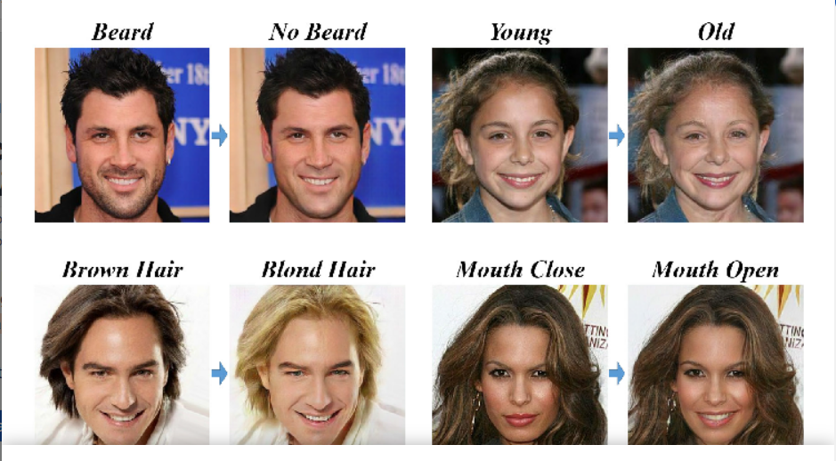
GAN
BLACK BOX ATTACKS ON INTERPRETABLE DEEPFAKE GANs
A. ATTRIBUTE MANIPULATION
Attribute manipulation, also known as face editing or face retouching, entails changing aspects of the face, such as hair or skin color, gender, age, and the addition of spectacles.
This manipulation process is usually carried out through a GAN, such as the StarGAN
Consumers may utilize this technology to test a wide range of items in a virtual environment, including cosmetics and makeup, spectacles, and hairstyles.

Slide 17
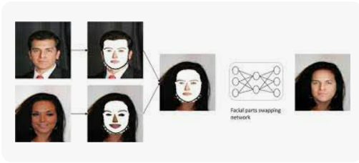
GAN
BLACK BOX ATTACKS ON INTERPRETABLE DEEPFAKE GANs
B. IDENTITY SWAP
The identity swap technique, also called the face-swap method, is very popular for replacing the face of one person in an image or video with that of another person.
Source image shows the identity, the target image provides the attributes and a swapped face image is generated
This type of method generates nonexisting face images, usually using a powerful GAN, suchas Style-GAN , StyleGAN2 and StyleGAN2-Ada . These approaches produce incredibleoutcomes, such as high-resolution facial images with a great degree of realism.

Slide 18
GAN
BLACK BOX ATTACKS ON INTERPRETABLE DEEPFAKE GANs
Datasets:
The CelebFaces Attributes Dataset (CelebA) is a large-scale face attribute dataset with more than200K celebrity images, each with 40 attribute annotations
The Diverse Fake Face Dataset (DFFD) dataset combines multiple forgery types (FaceSwap,Deepfake, DeepFaceLab, FaceAPP, StarGAN and StyleGAN) in a single dataset. DeepFake Detection(DFD) [55] was developed by Google and JigSaw

Slide 19
GAN
BLACK BOX ATTACKS ON INTERPRETABLE DEEPFAKE GANs
Paper 3 : StarGAN: Unified Generative Adversarial Networks for Multi-Domain
Image-to-Image Translation
Conference: CVF Conference on Computer Vision and Pattern Recognition
Authors: Yunjey Choi, Minje Choi, Munyoung Kim, Jung-Woo Ha, Sunghun Kim, Jaegul
Choo, Korea University, Clova AI Research, NAVER Corp, The College of New Jersey,
Hong Kong University of Science & Technology
Main focus is ATTRIBUTE MANIPULATION

Slide 20
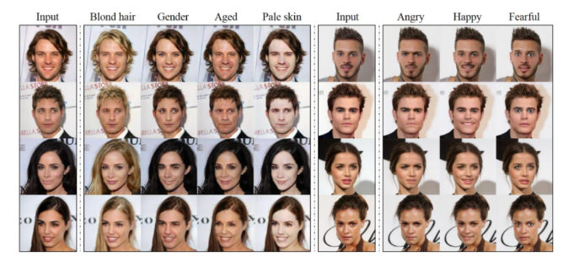
GAN
BLACK BOX ATTACKS ON INTERPRETABLE DEEPFAKE GANs
Existing approaches have limited scalability in handling more than two domains, since
different models should be built independently for every pair of image domains. To
address this limitation, they have proposed StarGAN, a novel and scalable approach that can
perform image-to-image translations for multiple domains using only a single model.

Slide 21
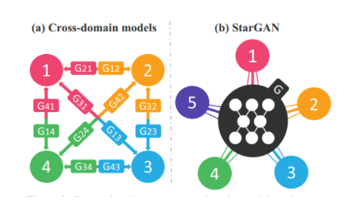
GAN
BLACK BOX ATTACKS ON INTERPRETABLE DEEPFAKE GANs
Datasets :
CelebA dataset contains 40 labels related
to facial attributes such as hair color, gender and age
RaFD dataset has 8 labels for facial
expressions such as ‘happy’, ‘angry’ and ‘sad’.
ISSUES :- difference in the number of attributes in
different datasets.
SOLUTION :- Mask Vector. To alleviate this problem, we introduce a mask vector that allows
StarGAN to ignore unspecified labels and focus on the explicitly known label provided by a
particular dataset

Slide 22
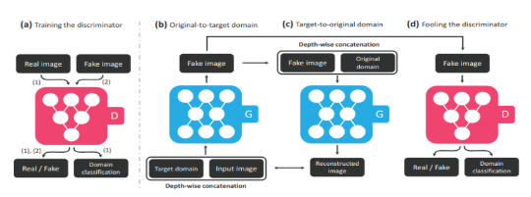
GAN
BLACK BOX ATTACKS ON INTERPRETABLE DEEPFAKE GANs
Overview of StarGAN, consisting of two modules, a discriminator D and a generator G
D learns to distinguish between real and fake images and classify the real images to its
corresponding domain.
G takes in both the image and target domain label as input and generates an fake image. The
target domain label is spatially replicated and concatenated with the input image.
G tries to reconstruct the original image from the fake image given the original domain label
G tries to generate images indistinguishable from real images and classifiable as target
domain by D.

Slide 23
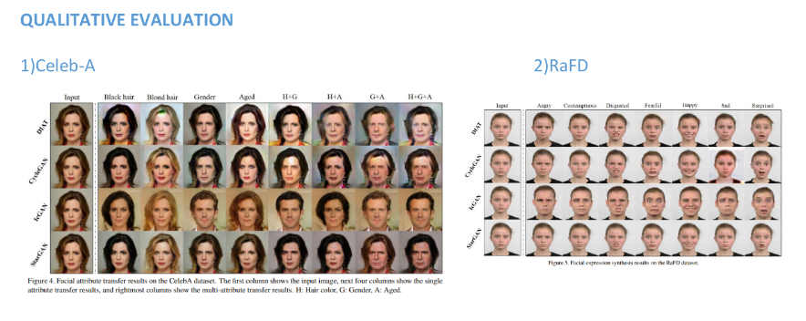
GAN
BLACK BOX ATTACKS ON INTERPRETABLE DEEPFAKE GANs

Slide 24
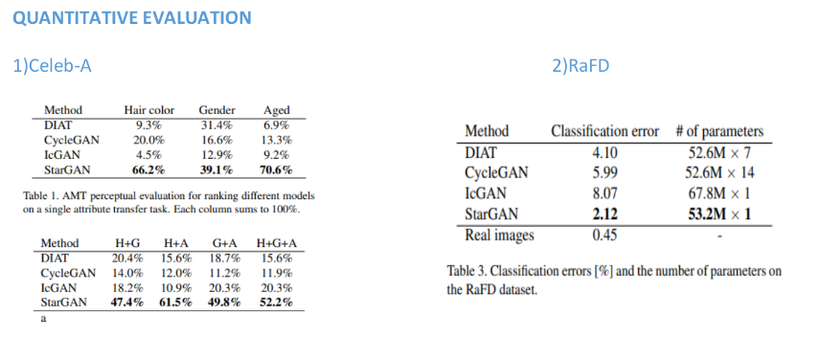
GAN
BLACK BOX ATTACKS ON INTERPRETABLE DEEPFAKE GANs

Slide 25
GAN
BLACK BOX ATTACKS ON INTERPRETABLE DEEPFAKE GANs

Slide 26
GAN
BLACK BOX ATTACKS ON INTERPRETABLE DEEPFAKE GANs
Paper 4: One Shot Face Swapping on Megapixels
Conference : 2021 IEEE/CVF Conference on Computer Vision and Pattern Recognition (CVPR)
Authors :Yuhao Zhu; Qi Li; Jian Wang; Chengzhong Xu; Zhenan Sun
Main focus is IDENTITY SWAP
Finally, the swapped faces can be synthesized by StyleGAN2 with the benefits of its training
stability and powerful generative capability.
Datasets: CelebA, CelebA-HQ, FFHQ, FaceForensics++

Slide 27
GAN
BLACK BOX ATTACKS ON INTERPRETABLE DEEPFAKE GANs
PROBLEMS FOCUSED IN THIS PAPER:
Information is insufficient for high-quality face generation due to the compressed
representation in an end-to-end framework .
Secondly, adversarial training is unstable , which confines the resolution of previous methods
only up to 2562 .
Thirdly, the GPU memory limitation makes the training untenable, or the training batch is
bounded by a small size, which aggravates the collapse of the training process.

Slide 28
GAN
BLACK BOX ATTACKS ON INTERPRETABLE DEEPFAKE GANs
SOLUTION :
This paper proposes the first Megapixel level one shot Face Swapping method (MegaFS) by
adopting the “divide and conquer” strategy in three steps.
To modify more than one attribute can be modified once a time, a novel swapping module, Face Transfer Module (FTM), is proposed to control multiple attributes synchronously without explicit feature disentanglement.
Each part of MegaFS can be trained separately so the GPU memory requirements are satisfied for megapixel face swapping.
To overcome the information loss in the encoder, we adopt GAN Inversion methods and propose a Hierarchical Representation Face Encoder (HieRFE) to find the complete face representation in an extended latent space W++.

Slide 29
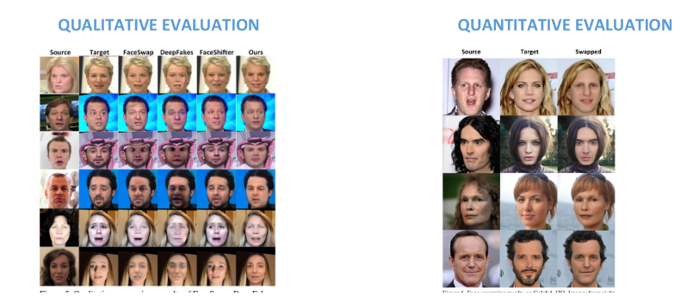
GAN
BLACK BOX ATTACKS ON INTERPRETABLE DEEPFAKE GANs
Evaluation

Slide 30
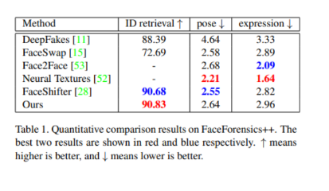
GAN
BLACK BOX ATTACKS ON INTERPRETABLE DEEPFAKE GANs
RESULT:
One superiority of our method is that
it can achieve megapixel level face swapping.
Faces can be swapped across various expressions
and poses.
The swapped faces faithfully keep wrinkles,
iris colors, eyebrow and nose shapes from
source faces.

Slide 31
INTERPRETERS
BLACK BOX ATTACKS ON INTERPRETABLE DEEPFAKE GANs
Paper 5: Explainable Deep-Fake Detection Using Visual Interpretability Method
Authors: Badrinarayan Malolan, Ankit Parekh, Faruk Kazi
Conference:ICICT
Year of publication:2020
Problem solved by the paper: detecting deep fake videos using visual interpretability methods and test the model on various explainable AI techniques.
Approach used: deep learning techniques with visual interpretability methods to provide a transparent and explainable deep fake detection system.
Dataset : Face Forensics Dataset, Deep Fake Detection (Google) Dataset
Evaluation metric: End goal of cultivating trust between AI practitioners and the target customers .

Slide 32
INTERPRETERS
BLACK BOX ATTACKS ON INTERPRETABLE DEEPFAKE GANs
Pros :
●Interpretability-where it provides an explanation for the detection of deep fake
●Method is flexible can be applied to different types of deepfakes like face swapping,lip syncing .
Cons:
●The method is tested on relatively less dataset
● It is complex since several steps are included.
● The method requires a significant amount of computing resources, including GPUs which may not be accessible for all users
Relevance to the project:
Our model can be used to test for the various XAI techniques mentioned in the paper

Slide 33
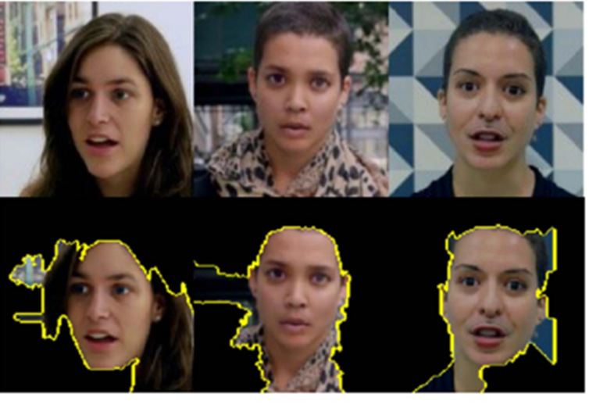
INTERPRETERS
BLACK BOX ATTACKS ON INTERPRETABLE DEEPFAKE GANs
In the image, the first row represents the input and the second row shows the LIME description which is able to capture the relevant areas surrounding the face that resulted in classification.

Slide 34
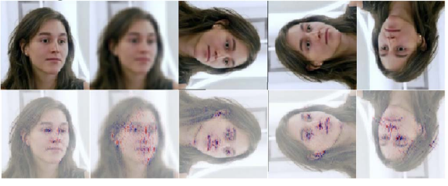
INTERPRETERS
BLACK BOX ATTACKS ON INTERPRETABLE DEEPFAKE GANs
. Layer-Wise Relevance Propagation (LRP)

Slide 35
INTERPRETERS
BLACK BOX ATTACKS ON INTERPRETABLE DEEPFAKE GANs
Paper 6: A Visually Interpretable Forensic Deepfake Detection Tool Using Anchors
Authors: Krishnakripa Jayakumar, Nimalaprakasan Skandhakumar
Conference: ICITR (International Conference on Information Technology Research)
Year of publication : 2022
Problem solved by the paper: increasing prevalence of deepfakes and the need for effective tools to detect them and the tool is based on ANCHORS.
Approach used :detect deepfakes using a technique called Anchors

Slide 36
INTERPRETERS
BLACK BOX ATTACKS ON INTERPRETABLE DEEPFAKE GANs
Dataset: DFDC and FaceForensics (FF) ++
Evaluation metric:
Fidelity Score = IE ÷ X × 100
IE is the number of (Interpretable) Explanations that the evaluators found to be human understandable/ interpretable and X is the number of total Explanations presented to the evaluators.
The system yielded 89.58% fidelity score in the human evaluation.
Anchor Affinity Score = HAE ÷ HE × 100
An anchor affinity score of 70.23% was derived through the human grounded evaluation.
HAE is number of Helpful Anchor explanations and HE is the number of all Helpful explanations.

Slide 37
INTERPRETERS
BLACK BOX ATTACKS ON INTERPRETABLE DEEPFAKE GANs
Pros: this method provides interpretability the tool uses "anchors" which are visual explanations of the decision-making process of the deep fake detection model. This helps in understanding how the model works and what factors are important in determining whether a video is a deep fake or not. , helps in forensic investigations.
Cons: Limited scope

Slide 38
DEFENSE
BLACK BOX ATTACKS ON INTERPRETABLE DEEPFAKE GANs
PAPER 5: Proper Network Interpretability Helps Adversarial Robustness in Classification
Authors: Akhilan Boopathy, Sijia Liu, Gaoyuan Zhang, Cynthia Liu, Pin-Yu Chen, Shiyu Chang, Luca Daniel
Conference: ICML 2020
Problem solved by paper: Achieve both robust classification and robust interpretation
The approach applied in the paper relies on the fact that vulnerability of image classifier against adversarial input is accompanied by interpretation discrepancy only if properly measured.
CAM and GradCAM are used as they better localise class-specific discriminative regions.
By replacing the input image x with x’ , a CNN will be fooled from the true label y to the target (incorrect) label y’ .

Slide 39
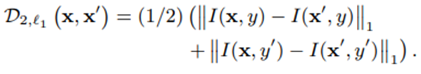
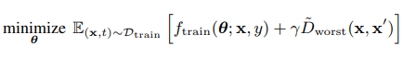
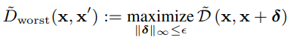
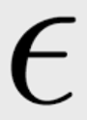
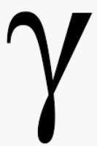
DEFENSE
BLACK BOX ATTACKS ON INTERPRETABLE DEEPFAKE GANs
Single-class interpretation discrepancy measure (either y or y') is not always effective.
Introduces l1 2-class interpretation discrepancy measure.
The target label used by the attacker is not known beforehand,
therefore softmax function is used to approximate the interpretation discrepancy.
The classifier is trained against the worst-case scenario by modifying the loss function as:
The perturbation size ( ) depends on the dataset being used and the paper uses a value of 0.3 for MNIST dataset.
The regularization parameter is set to 0.001. ( )
This approach has been employed in the base paper and can be used in our project as well.

Slide 40
DEFENSE
BLACK BOX ATTACKS ON INTERPRETABLE DEEPFAKE GANs
PAPER 6: GRIP-GAN- An Attack-Free Defense Through General Robust Inverse Perturbation
Authors: Haibin Zheng, Jinyin Chen, Hang Du, Weipeng Zhu, Shouling Ji, Xuhong Zhang
Journal: IEEE TRANSACTIONS ON DEPENDABLE AND SECURE COMPUTING, VOL. 19, NO. 6, NOVEMBER/DECEMBER 2022
Publisher: IEEE
Approach:
GRIP is the abbreviation for General Robust Inverse Perturbation
The concept is adapted from Universal Adversarial Perturbation attack, which aims to find a single value that causes natural images to be misclassified with high probability.

Slide 41
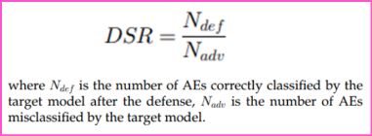
DEFENSE
BLACK BOX ATTACKS ON INTERPRETABLE DEEPFAKE GANs
Let X={x1, x2, ... , xm} be a set of clean examples, and X*= {x*1, x*2, ..., x*m} be the corresponding AEs.
Find GRIP v, such that l ̂(x_i+v)=l ̂(x_i ) while defending most examples in X* as l ̂(x_i^∗+v)=l ̂(x_i ).
Static GRIP is not feasible against unconstrained attacks, the paper proposes to dynamically generate GRIP value
GRIP is added to the clean examples to obtain the GRIP-added examples (xi + v) by the generator which will be the input of the discriminator.
Limitation of using this approach: GRIP-GAN is not highly effective in defending against attacks that have large perturbations.
The evaluation metric used is Defense Success Rate (DSR).
The GAN architecture can be modified to include the generation of GRIP value.

Slide 42
Suggestions from Review - 3
BLACK BOX ATTACKS ON INTERPRETABLE DEEPFAKE GANs
Understand the algorithms associated with Dual Black Box Attack (ADV Plugin).
Modify overall System Architecture.

Slide 43
Design Constraints, Assumptions & Dependencies
BLACK BOX ATTACKS ON INTERPRETABLE DEEPFAKE GANs
Design Constraints:
Accuracy requirements – The accuracy of the attack will determine the defense algorithm used.
Computational resources – The models used are complex and the dataset is large
Design Dependencies:
Hardware dependencies - There is a requirement for GPU.
Software dependencies - The software used to develop, train, and deploy the machine learning model can impact its performance and ease of use.

Slide 44
Design Details
BLACK BOX ATTACKS ON INTERPRETABLE DEEPFAKE GANs
For user interface, Gradio (compatible with Python) is being used.
The different libraries used are: Tensorflow, Keras.

Slide 45
Proposed Methodology / Approach
BLACK BOX ATTACKS ON INTERPRETABLE DEEPFAKE GANs
The approach followed in this project includes:
Dataset Used: Celeb-A for creation of Deepfake images
Large-scale face attributes dataset with more than 200K celebrity images, each with 40 attribute annotations. The images in this dataset cover large pose variations and background clutter. CelebA has large diversities, large quantities, and rich annotations, including
10,177 number of identities,
202,599 number of face images
Model Selection: Star- GAN and Style- GAN
Model Evaluation: Classification Accuracy and IoU (Intersection over Union) score
Attack Performed: Dual Black Box attack
Defense Methods: GRIP- GAN and IART

Slide 46
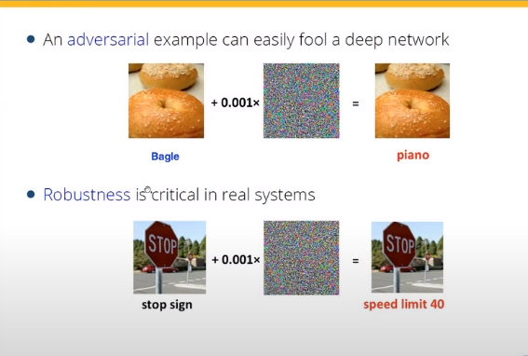
Architecture
BLACK BOX ATTACKS ON INTERPRETABLE DEEPFAKE GANs
Adversarial Example

Slide 47
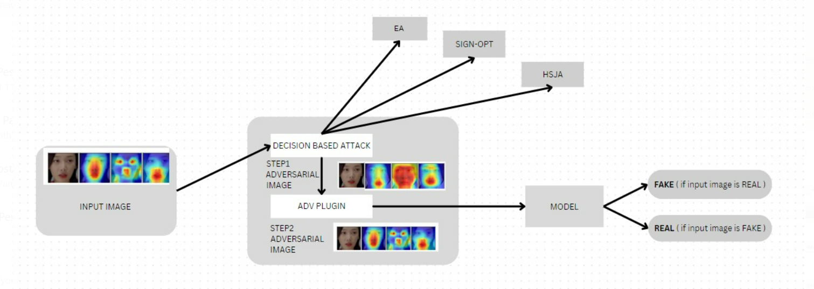
Architecture
BLACK BOX ATTACKS ON INTERPRETABLE DEEPFAKE GANs
ATTACK [ Model is Unkown]

Slide 48
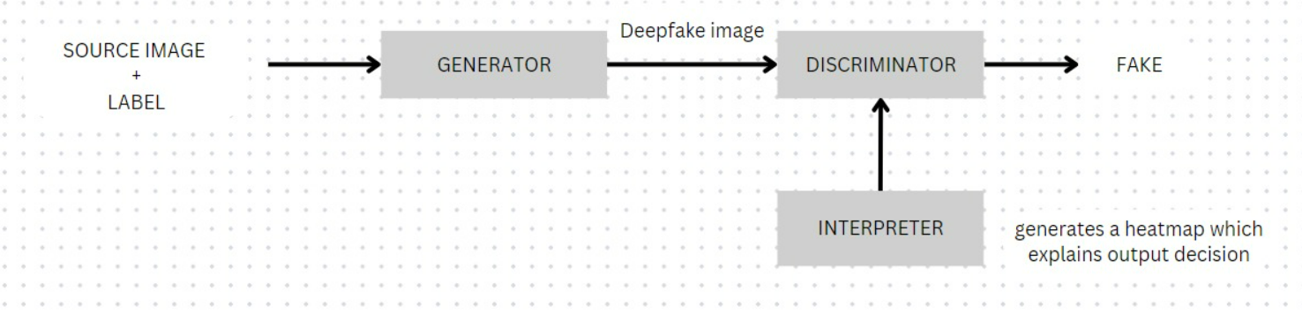
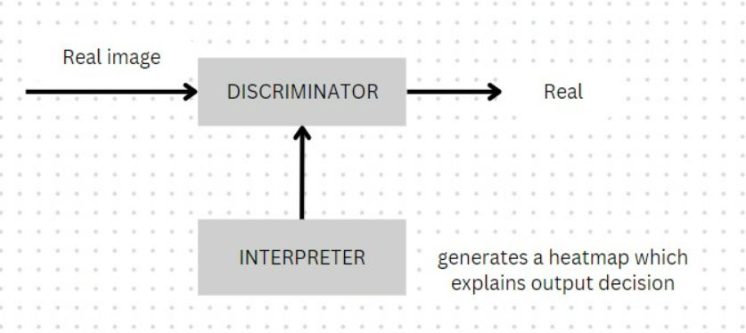
Architecture
BLACK BOX ATTACKS ON INTERPRETABLE DEEPFAKE GANs
STAR-GAN

Slide 49
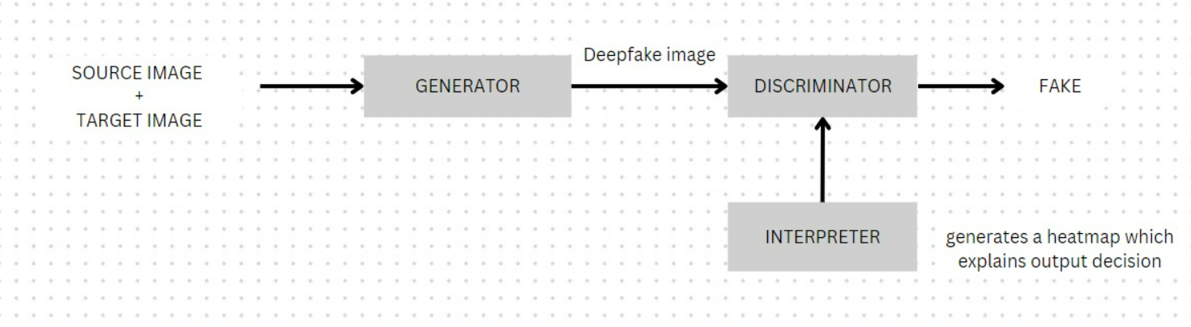
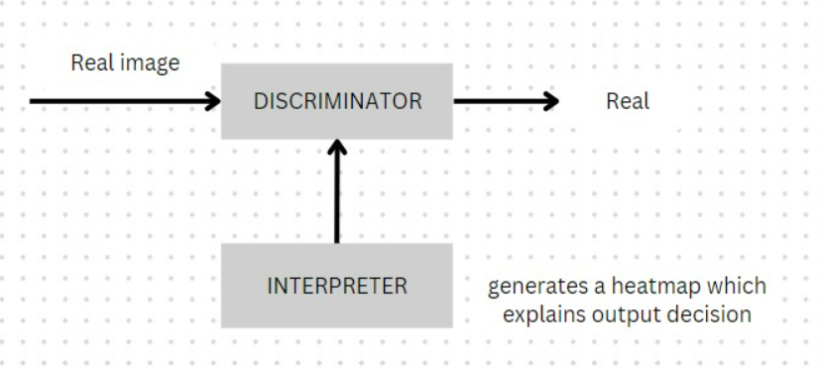
ARCHITECTURE
BLACK BOX ATTACKS ON INTERPRETABLE DEEPFAKE GANs
STYLE GAN

Slide 50
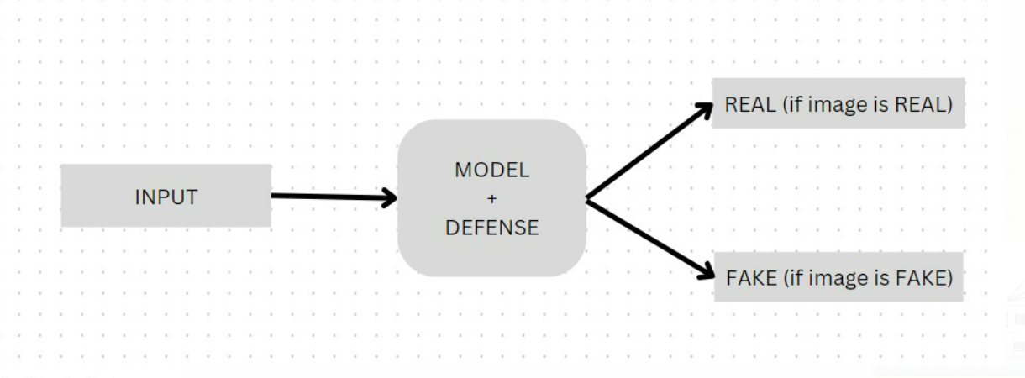
ARCHITECTURE
BLACK BOX ATTACKS ON INTERPRETABLE DEEPFAKE GANs
DEFENSE [MODEL IS KNOWN ]

Slide 51
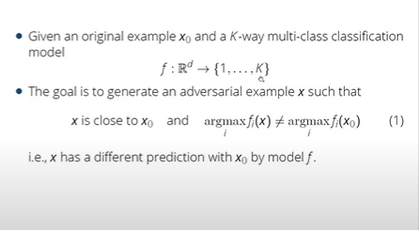
SIGN-OPT
BLACK BOX ATTACKS ON INTERPRETABLE DEEPFAKE GANs

Slide 52
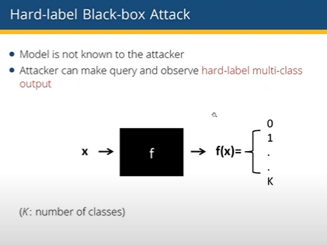
SIGN-OPT
BLACK BOX ATTACKS ON INTERPRETABLE DEEPFAKE GANs

Slide 53
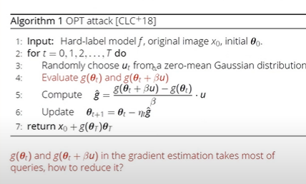
SIGN-OPT
BLACK BOX ATTACKS ON INTERPRETABLE DEEPFAKE GANs
Traditional OPT Method

Slide 54
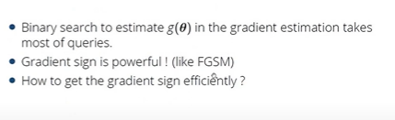
SIGN-OPT
BLACK BOX ATTACKS ON INTERPRETABLE DEEPFAKE GANs
SIGN is enough!!

Slide 55
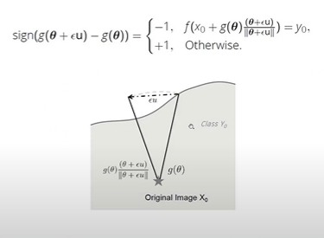
SIGN-OPT
BLACK BOX ATTACKS ON INTERPRETABLE DEEPFAKE GANs
SIGN is enough!!

Slide 56
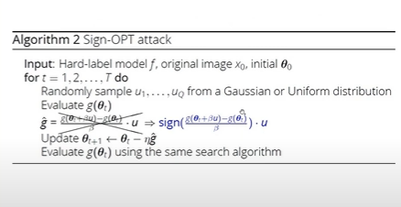
SIGN-OPT
BLACK BOX ATTACKS ON INTERPRETABLE DEEPFAKE GANs
SIGN is enough!!

Slide 57
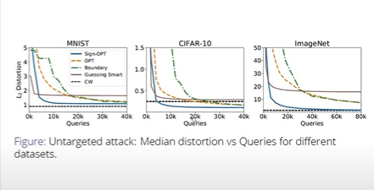
SIGN-OPT
BLACK BOX ATTACKS ON INTERPRETABLE DEEPFAKE GANs
SIGN is enough!!

Slide 58
Project Progress
BLACK BOX ATTACKS ON INTERPRETABLE DEEPFAKE GANs
The project is in initial stages of implementation.

Slide 59
Summary of work done in Capstone Phase-1
BLACK BOX ATTACKS ON INTERPRETABLE DEEPFAKE GANs
Literature Survey to finalise on
Type of Generative Adversarial Network (GAN) model to use
Possible defenses
Detailed system design to get clear idea of component interaction
Attack Structure

Slide 60
Project Plan for Capstone Phase-2
BLACK BOX ATTACKS ON INTERPRETABLE DEEPFAKE GANs
Customise Style-GAN for project.
Integrate Style-GAN with Grad-CAM interpreter.
Replicate dual black-box attack on ResNet50 using ImageNet dataset.

Slide 61
References
BLACK BOX ATTACKS ON INTERPRETABLE DEEPFAKE GANs
A. Malik, M. Kuribayashi, S. M. Abdullahi and A. N. Khan, "DeepFake Detection for Human Face Images and Videos: A Survey," in IEEE Access, vol. 10, pp. 18757-18775, 2022, doi: 10.1109/ACCESS.2022.3151186.
Zhu, Q. Li, J. Wang, C. Xu, and Z. Sun, “One Shot Face Swapping on Megapixels,” arXiv:2105.04932 [cs], Available: https://arxiv.org/abs/2105.0493
Choi, Y. et al. (2018) Stargan: Unified generative adversarial networks for multi-domain image-to-image translation, arXiv.org. Available at: https://arxiv.org/abs/1711.09020

Slide 62
References
BLACK BOX ATTACKS ON INTERPRETABLE DEEPFAKE GANs
B. Malolan, A. Parekh and F. Kazi, "Explainable Deep-Fake Detection Using Visual Interpretability Methods," 2020 3rd International Conference on Information and Computer Technologies (ICICT), San Jose, CA, USA, 2020, pp. 289-293, doi: 10.1109/ICICT50521.2020.00051.
K. Jayakumar and N. Skandhakumar, "A Visually Interpretable Forensic Deepfake Detection Tool Using Anchors," 2022 7th International Conference on Information Technology Research (ICITR), Moratuwa, Sri Lanka, 2022, pp. 1-6, doi: 10.1109/ICITR57877.2022.9993294.
T. Bai et al., "AI-GAN: Attack-Inspired Generation of Adversarial Examples," 2021 IEEE International Conference on Image Processing (ICIP), Anchorage, AK, USA, 2021, pp. 2543-2547, doi: 10.1109/ICIP42928.2021.9506278.

Slide 63
References
BLACK BOX ATTACKS ON INTERPRETABLE DEEPFAKE GANs
S. Zhao, J. Li, J. Wang, Z. Zhang, L. Zhu, and Y. Zhang, “attackGAN: Adversarial Attack against Black-box IDS using Generative Adversarial Networks,” Procedia Computer Science, vol. 187, pp. 128–133, 2021, doi: https://doi.org/10.1016/j.procs.2021.04.118.
H. Zheng, J. Chen, H. Du, W. Zhu, S. Ji and X. Zhang, "GRIP-GAN: An Attack-Free Defense Through General Robust Inverse Perturbation," in IEEE Transactions on Dependable and Secure Computing, vol. 19, no. 6, pp. 4204-4224, 1 Nov.-Dec. 2022, doi: 10.1109/TDSC.2021.3124337.
Boopathy, A. et al. (2020) Proper network interpretability helps adversarial robustness in classification, arXiv.org. Available at: https://arxiv.org/abs/2006.14748

Slide 64
Any other information
Title of the Project
Provide any other information you wish to add on.
Note: Changes can be made in the template, with the consent of the guide for inclusion of any other information.

Slide 65
Title of the Project
Thank You

